Slide 1
Organizing 101
Statewide Organizing Director
Patricia Arroyos

Slide 2
What is Organizing?
The process of building power through determining what people want as individuals and then helping them find collective ways of getting it
The personal is political: Organizing is overwhelmingly about building relationships - changing the world and changing how individuals act together
Notes:
Credit to Midwest Academy and Marshall Ganz

Slide 3
Foundation for Organizing - Self-Care
What is Self-Care?
A personal, individual process that involves looking holistically into several levels of well-being - the ability to proactively enhance our health by building resiliency
Why is Self-Care Necessary?
Let’s be real, this work isn’t easy BUT a Healthier YOU → Healthier Movement
“Caring for myself is not self-indulgence, it is self-preservation, and that is an act of political warfare.” -Audre Lorde
Integrating self-care into your daily life requires planning

Slide 4
Roles in Movement Building
True of False:
Movements are lit like a match
Movements are built by heroic figure head leaders
Movements require complete internal unity
Movements succeed if they mobilize large, mass actions.

Slide 5
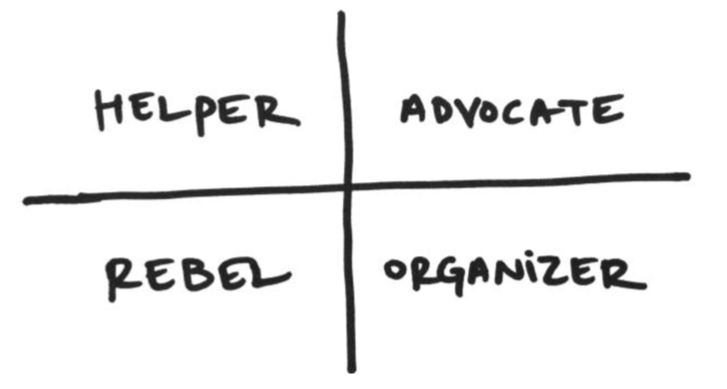
Your Role in Social Change

Slide 6
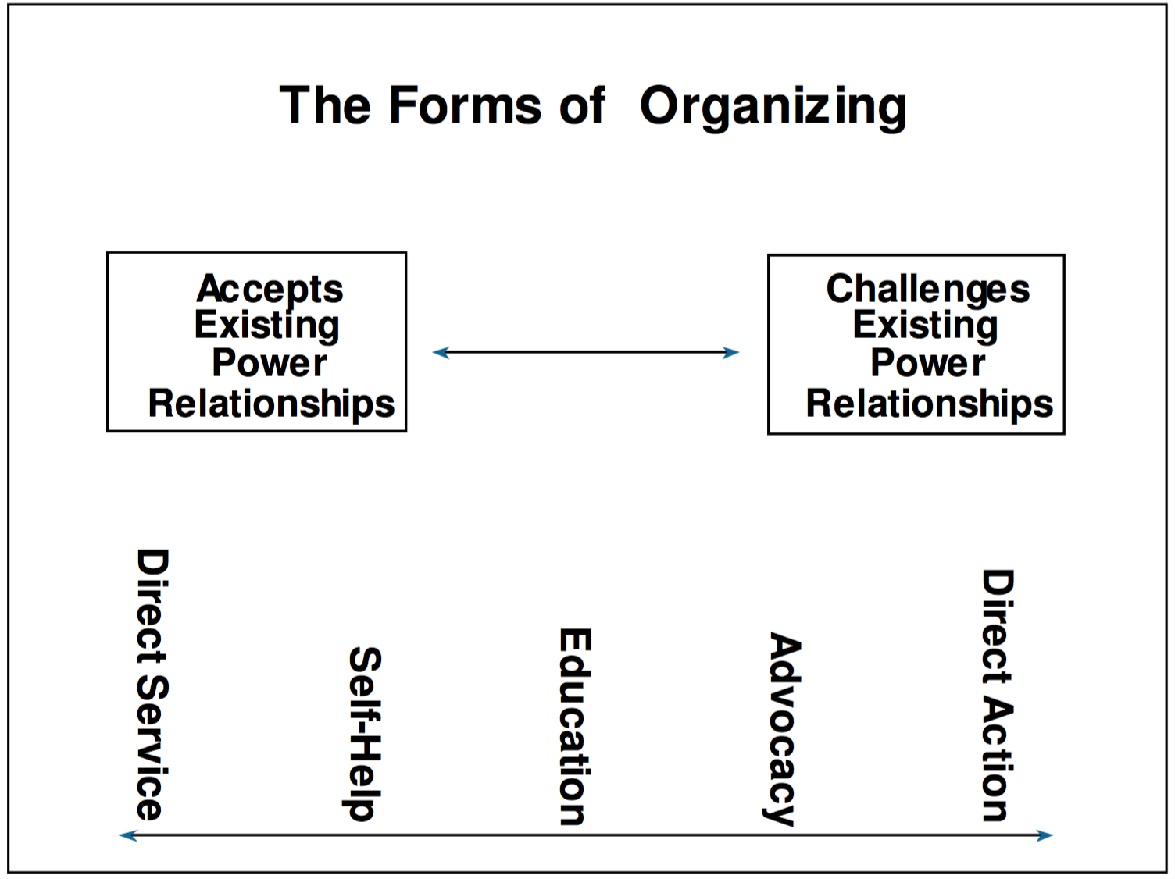

Slide 7
3 Basic Principles of Direct Action Organizing
Win concrete improvements in people's lives.
Make students aware of their own power
Alter the relations of power between students, the administration, the legislature and federal government

Slide 8
8 Steps to Direct Action Organizing
Identify a Problem
Choose an Issue
Develop a Strategy
Involve Large Number of Students Face to Face w/ Target
Target Reacts
Depending on Outcome - Regroup
Take Advantage of Elections
Keep Legislators Accountable to Demands

Slide 9
Big Problems vs Specific Issues
Higher Ed is Unaffordable vs CA State Divestment in Higher Ed
College Rape Culture vs Rape Culture in the UC
Racial Relations in the US vs #BlackLivesMatter
Prison Industrial Complex vs UC workers’ pensions invested in private prisons

Slide 10
Theory of Change
Notes:
Head and the Heart of Organizing – The How and the Why = Meaningful Action

Slide 11
What is a Strategy?
Strategy is turning the RESOURCES you have into the POWER you need to get the CHANGE you want

Slide 12
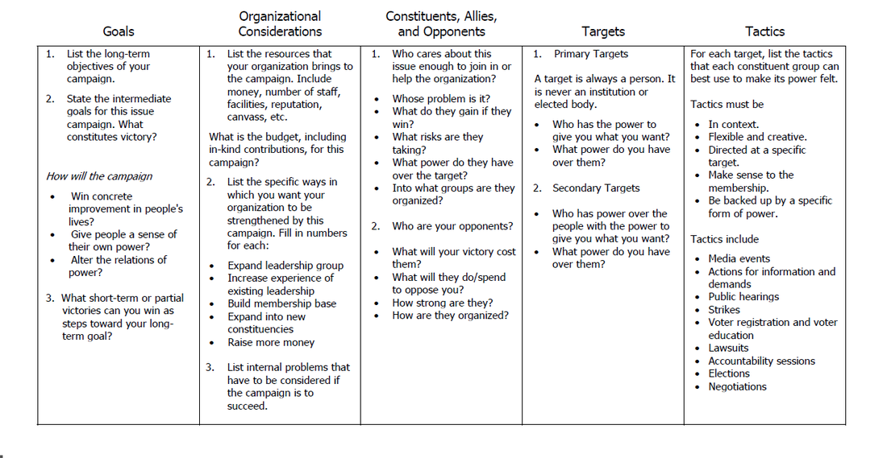
Strategy

Slide 13
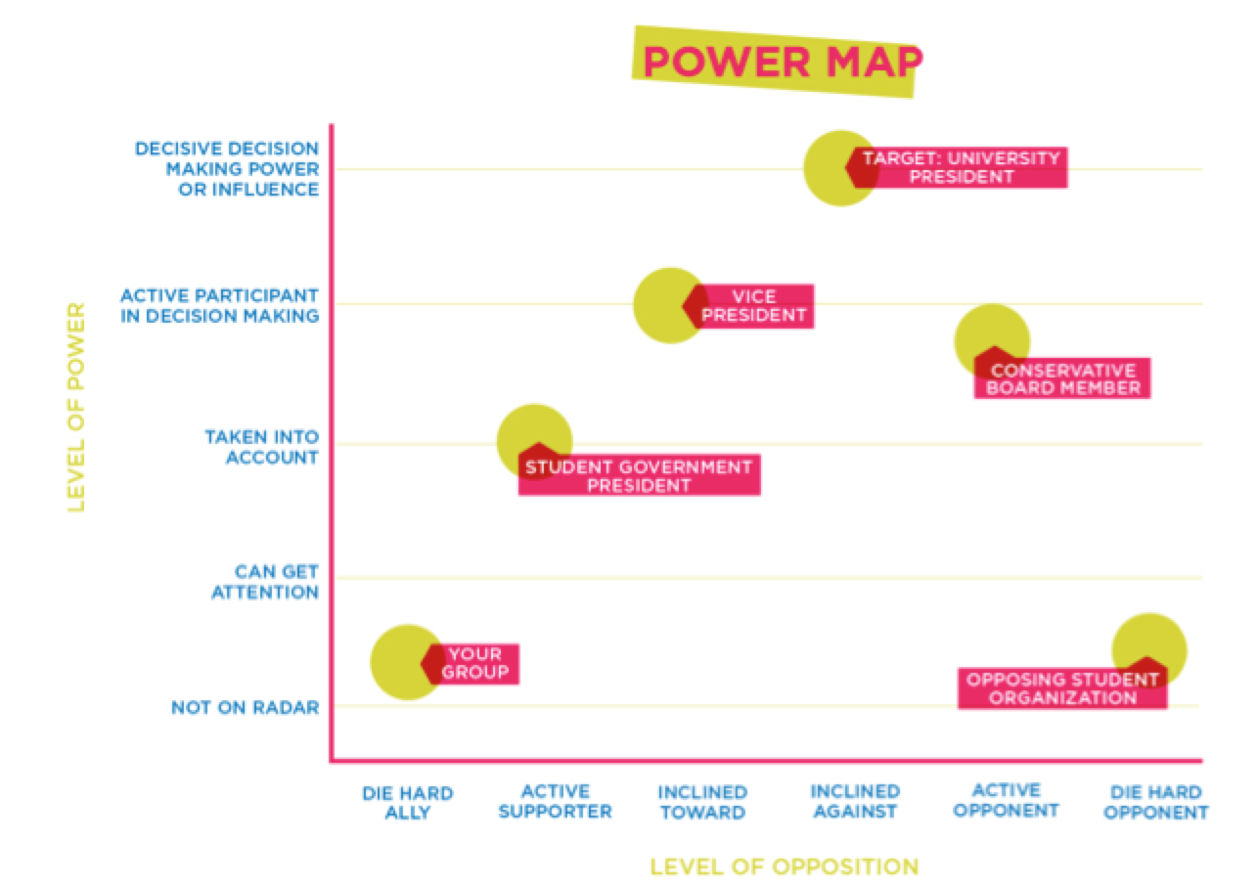
What is Power Mapping?
Power Mapping is a visual tool to analyze power relationships around an issue or agenda. It is also a framework for problem solving through relationship building.
Power mapping helps analyze current power relationships, determine who/what you need to win (key targets, coalition partners, etc.) and develop a strategy to change the power relationships necessary to win.
This process will help teach you the value of personal relationships as an important dynamic in social organizing.

Slide 14
Power & Tactics
Traditional Forms of Power
Political/Legislative Power: Getting something passed by a legislative body
Consumer Power: The ability to conduct a boycott
Legal/Regulatory Power: The ability to win in court or the regulatory process
Strike/Disruptive Power: Cutting off profits or income by stopping the university from functioning
Other
How it can be used on campus
Threatening to go around elected officials and use the legislative/political process. Passing state propositions or laws the UC would have to follow. Impacting the Governor’s race and dictating who gets appointed to the Board of Regents.
Cut-off profits that students generate (athletic tickets, apparel, public dorms, campus food).
Sue or file a claim against the UC (Kashmiri Case).
Affect campus enrollment numbers or fundraising.
Negative Press about a powerful Regent, Administrator or Donor.

Slide 15
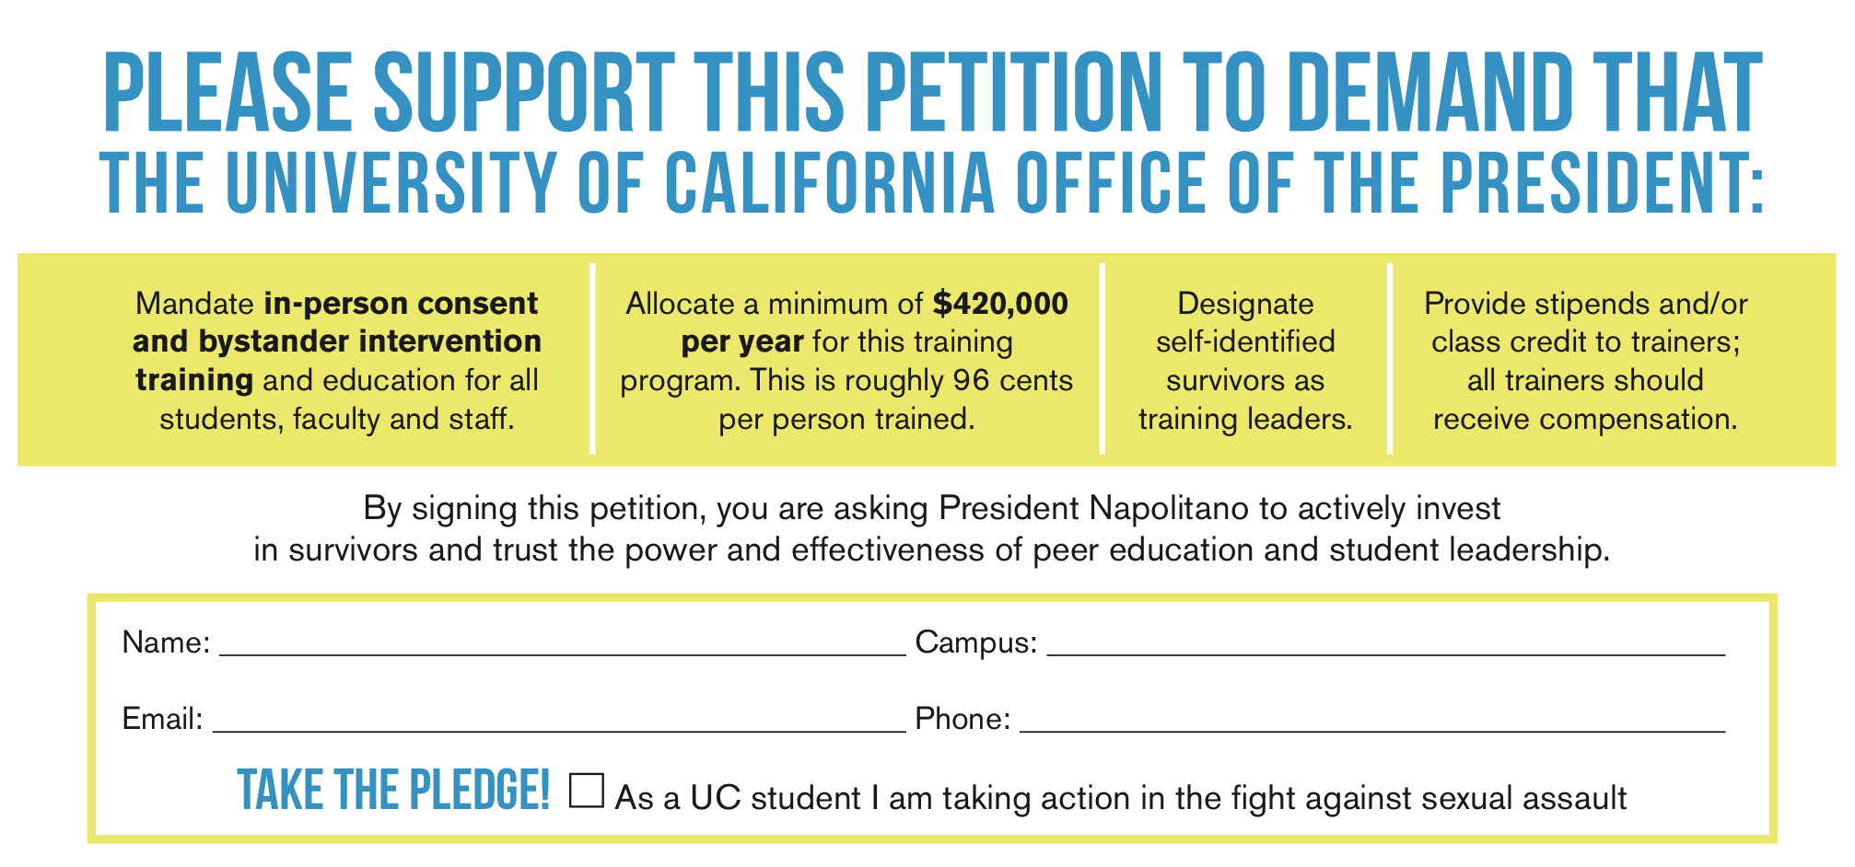
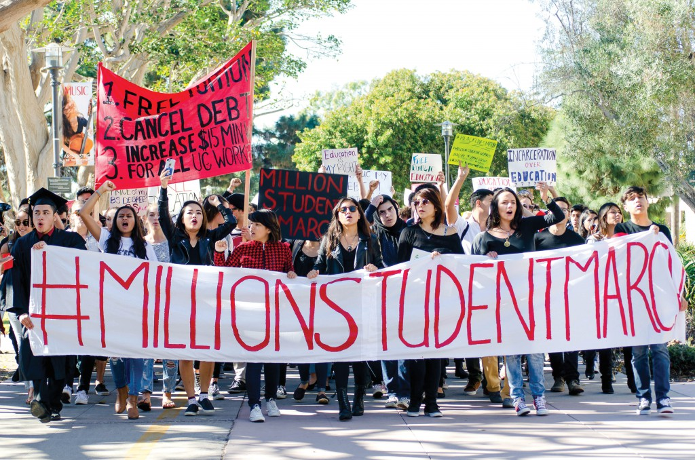
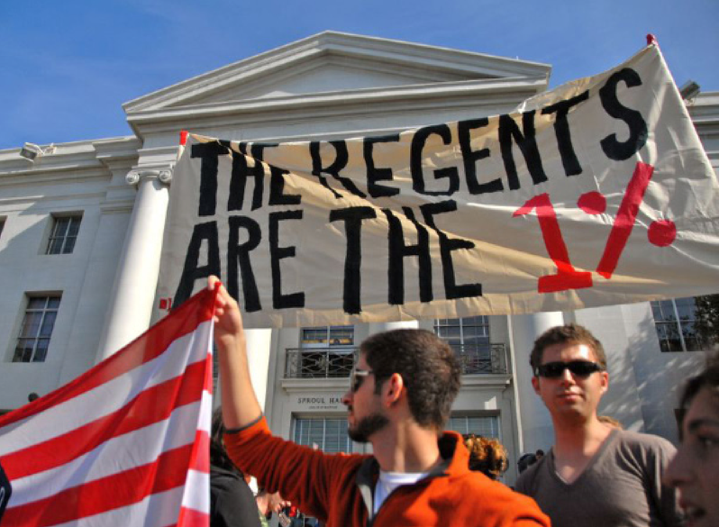
Different Kinds of Tactics
Petition Drives
Letter Writing
Visits with Public Officials
Public Hearings
Mass Demonstrations
Teach-Ins
Educational Events
Civil Disobedience
Boycotts
Marches
UC Specific Tactics - As a student
Class Raps/Tabling/Canvassing
Meeting with leadership from an organization
Meeting with an administrator

Slide 16
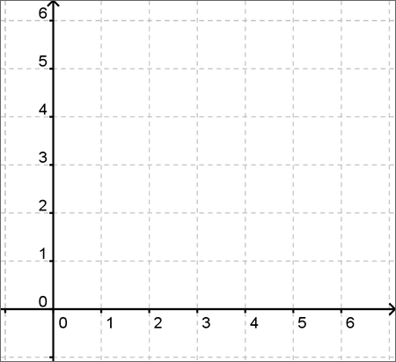
Escalation Chart
Logical Order to Using Tactics

Slide 17
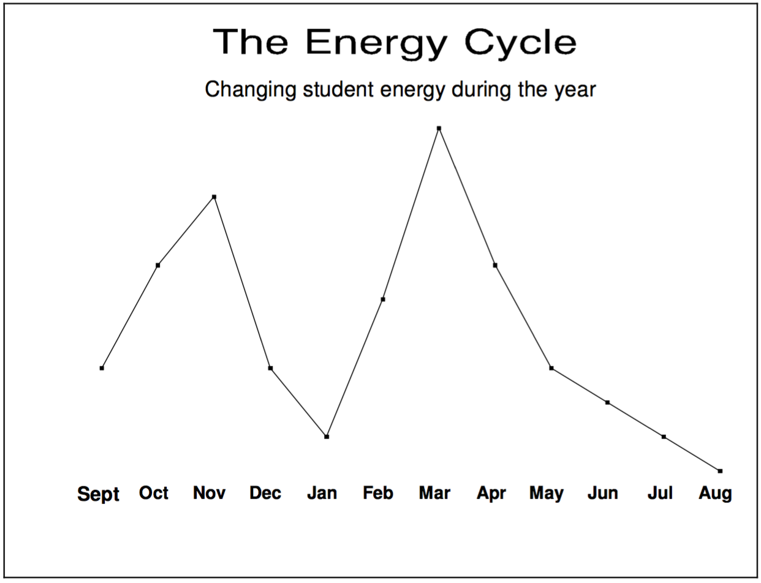

Slide 18
Recap
TACTICS are what our CONSTITUENTS do to the TARGETS to pressure the TARGETS to give us our GOALS and build the ORGANIZATION

Slide 19
How Do We Get Started? – What Does it take to Base Build?

Slide 20
The Organizing Conversation
Intro - Getting in the Door
Digging
Agitation
Inoculation
Plan to Win
Concrete/ Hard Ask

Slide 21
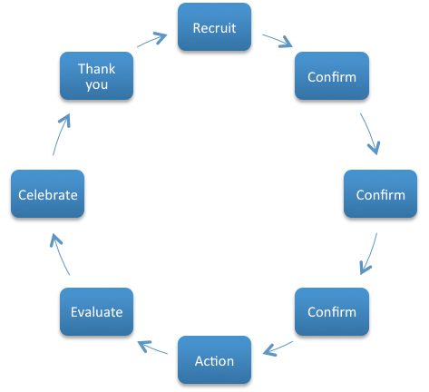
Getting Commitment

Slide 22
Social Media: Principles for Organizers
Only 20% of posts make it to a user’s feed.
Social media is about conversation.
Social media is the weakest commitment you can get.
A powerful message is still the most important thing.
Deleting negative feedback hurts you in the end.

Slide 23
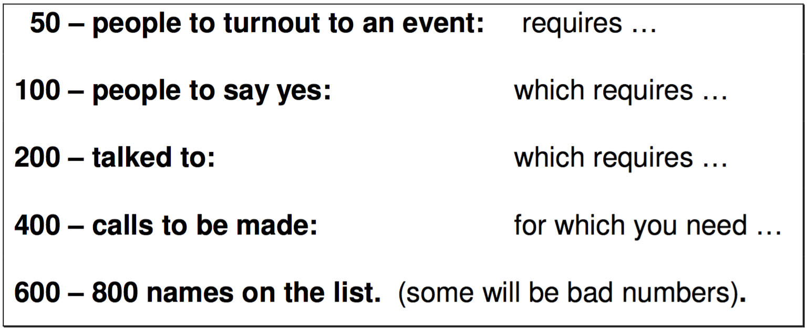
Rule of Halves

Slide 24
Privilege and Allyship in Coalition Building
Given the political climate, there a more opportunities for us to play a role, BUT an intentional one
Everyone should see their investment in dismantling systems of oppression and an ally is an individual/group that actively uses their privilege and/or positionality to assist historically marginalized communities in doing so
Allyship is a conscious mindset, not an identity

Slide 25
What’s Next?
As a student here at UCSD there a lot of ways to get involved
Connect to SAAC (Student Affirmative Action Committee) Leaders
Connect to the External Affairs Office – Statewide Advocacy
Call to ACTION → Regents Mtg Action Wed. May 17th at UCSF Sign-Up Sheet: www.tinyurl.com/uscdregents

Slide 26
Details of Action
When: Wednesday, May 17th
Where: UCSF Mission Bay
Bus leaves UCSD – Tuesday, May 16th
SIGN UP HERE: www.tinyurl.com/uscdregents

Slide 27
Questions?
Contact Info:
Paty Arroyos – UCSA Statewide Organizing Director
Phone: (510) 282-1736
Email: organizing@ucsa.org
Request a Training! – www.ucsa.org/resources/trainings

